Slide 1
Coordinate systems and transformations

Slide 2
Today
Project 2 - Architecture
OpenGL
GL_POINTS
GL_LINES
GL_LINE_STRIP
GL_LINE_LOOP
GL_TRIANGLES
Transformation
GL_TRIANGLE_STRIP
GL_TRIANGLE_FAN
GL_QUADS
GL_QUAD_STRIP
GL_POLYGON

Slide 3
OpenGL環境設置
下載網址：http://www.opengl.org/resources/libraries/glut/glutdlls37beta.zip
環境設置：
將glut32.dll放到C:\WINDOWS\system32目錄下
將glut32.lib和opengl32.lib放到C:\Program Files\Microsoft Visual Studio 10.0\VC\Lib目錄下
將glut.h放到C:\Program Files\Microsoft Visual Studio 9.0\VC\ Include\GL\目錄下

Slide 4
Drawing Primitives
void drawMyStuff(void) {
glBegin (...);
//glColor3f(1.0f, 1.0f, 1.0f);
//glNormal3f(0.0f, 0.0f, 1.0f);
glVertex3f(1.0f, 1.0f, 1.0f);
glVertex3f(1.0f, 2.0f, 1.0f);
:
:
glEnd();
}

Slide 5
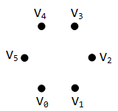
OpenGL Primitives
GL_POINTS GL_LINES GL_LINE_STRIP GL_LINE_LOOP GL_TRIANGLES GL_TRIANGLE_STRIP GL_TRIANGLE_FAN GL_QUADS GL_QUAD_STRIP GL_POLYGON

Slide 6
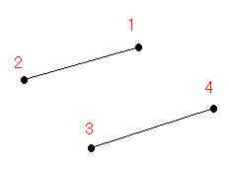
OpenGL Primitives
GL_POINTS GL_LINES GL_LINE_STRIP GL_LINE_LOOP GL_TRIANGLES GL_TRIANGLE_STRIP GL_TRIANGLE_FAN GL_QUADS GL_QUAD_STRIP GL_POLYGON

Slide 7
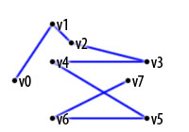
OpenGL Primitives
GL_POINTS GL_LINES GL_LINE_STRIP GL_LINE_LOOP GL_TRIANGLES GL_TRIANGLE_STRIP GL_TRIANGLE_FAN GL_QUADS GL_QUAD_STRIP GL_POLYGON

Slide 8
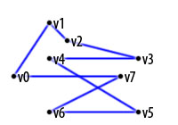
OpenGL Primitives
GL_POINTS GL_LINES GL_LINE_STRIP GL_LINE_LOOP GL_TRIANGLES GL_TRIANGLE_STRIP GL_TRIANGLE_FAN GL_QUADS GL_QUAD_STRIP GL_POLYGON

Slide 9
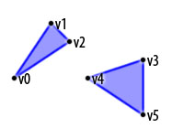
OpenGL Primitives
GL_POINTS GL_LINES GL_LINE_STRIP GL_LINE_LOOP GL_TRIANGLES GL_TRIANGLE_STRIP GL_TRIANGLE_FAN GL_QUADS GL_QUAD_STRIP GL_POLYGON

Slide 10
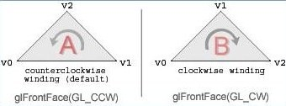
Ordering of Vertices
void glFrontFace (GLenum mode)
mode can be either GL_CW or GL_CCW
GL_CCW is the default

Slide 11
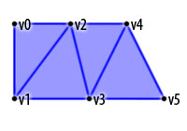
OpenGL Primitives
GL_POINTS GL_LINES GL_LINE_STRIP GL_LINE_LOOP GL_TRIANGLES GL_TRIANGLE_STRIP GL_TRIANGLE_FAN GL_QUADS GL_QUAD_STRIP GL_POLYGON

Slide 12
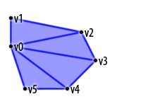
OpenGL Primitives
GL_POINTS GL_LINES GL_LINE_STRIP GL_LINE_LOOP GL_TRIANGLES GL_TRIANGLE_STRIP GL_TRIANGLE_FAN GL_QUADS GL_QUAD_STRIP GL_POLYGON

Slide 13
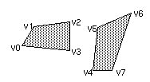
OpenGL Primitives
GL_POINTS GL_LINES GL_LINE_STRIP GL_LINE_LOOP GL_TRIANGLES GL_TRIANGLE_STRIP GL_TRIANGLE_FAN GL_QUADS GL_QUAD_STRIP GL_POLYGON

Slide 14
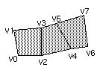
OpenGL Primitives
GL_POINTS GL_LINES GL_LINE_STRIP GL_LINE_LOOP GL_TRIANGLES GL_TRIANGLE_STRIP GL_TRIANGLE_FAN GL_QUADS GL_QUAD_STRIP GL_POLYGON

Slide 15
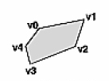
OpenGL Primitives
GL_POINTS GL_LINES GL_LINE_STRIP GL_LINE_LOOP GL_TRIANGLES GL_TRIANGLE_STRIP GL_TRIANGLE_FAN GL_QUADS GL_QUAD_STRIP GL_POLYGON
1. Must be convex
2. Cannot intersect

Slide 16

Color Blending
glColor3f (1.0, 0.0f, 0.0f);
glBegin(GL_TRIANGLES);
glVertex3f(-1.0f, -0.5f, 1.0f); // A
glVertex3f( 1.0f, -0.5f, 1.0f); // B
glVertex3f( 0.0f, 0.5f, 1.0f); // C
glEnd();

Slide 17
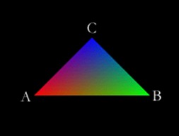
Color Blending
glShadeModel( GL_SMOOTH );
glBegin(GL_TRIANGLES);
glColor3f(1.0f, 0.0f, 0.0f);
glVertex3f(-1.0f, -0.5f, 1.0f); // A
glColor3f(0.0f, 1.0f, 0.0f);
glVertex3f( 1.0f, -0.5f, 1.0f); // B
glColor3f(0.0f, 0.0f, 1.0f);
glVertex3f( 0.0f, 0.5f, 1.0f); // C
glEnd();

Slide 18
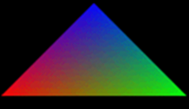
GL Shade Model
glShadeModel( GL_FLAT );
glBegin(GL_TRIANGLES);
glColor3f(1.0f, 0.0f, 0.0f);
glVertex3f(-1.0f, -0.5f, 1.0f); // A
glColor3f(0.0f, 1.0f, 0.0f);
glVertex3f( 1.0f, -0.5f, 1.0f); // B
glColor3f(0.0f, 0.0f, 1.0f);
glVertex3f( 0.0f, 0.5f, 1.0f); // C
glEnd();

Slide 19

GL Shade Model
glShadeModel( GL_FLAT );
glBegin(GL_TRIANGLES);
glColor3f(1.0f, 0.0f, 0.0f);
glVertex3f(-1.0f, -0.5f, 1.0f); // A
glColor3f(0.0f, 1.0f, 0.0f);
glVertex3f( 1.0f, -0.5f, 1.0f); // B
glColor3f(0.0f, 0.0f, 1.0f);
glVertex3f( 0.0f, 0.5f, 1.0f); // C
glEnd();

Slide 20
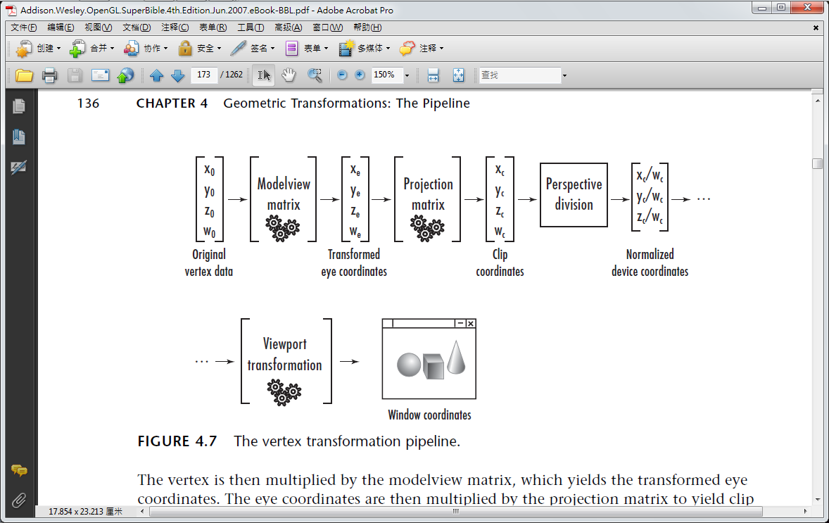
Graphics Pipeline (1/2)

Slide 21
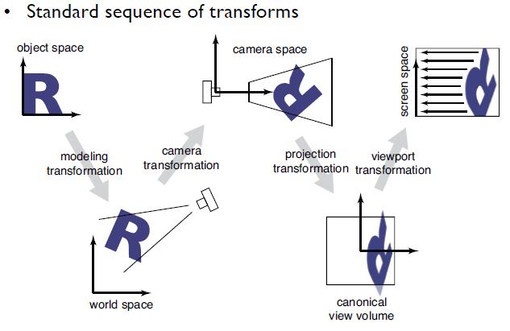
Graphics Pipeline (2/2)
Local Coordinate Space
World Coordinate Space
View Space
Canonical View Volume
Display Space

Slide 22
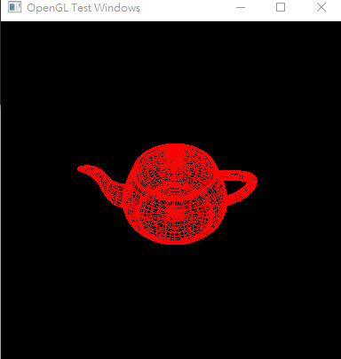
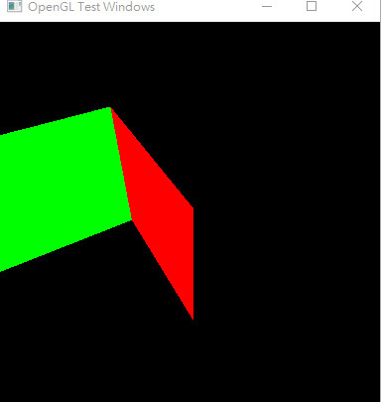
Render a 3D Object

Slide 23
小考
Write a render function that takes in two parameters, radius and slices, and produces a 2D circle drawn as a set of polylines (assume centered at (0,0))
That is, fill in this function:
void drawCircle2D(float radius, int slices) {
:
:
glBegin (...);
for (int i=0; i<...) {
:
:
glVertex2f(...);
glColor3f(...);
}
glEnd();
}

Slide 24
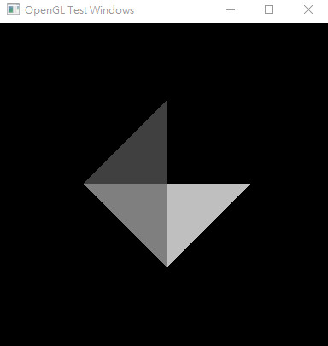
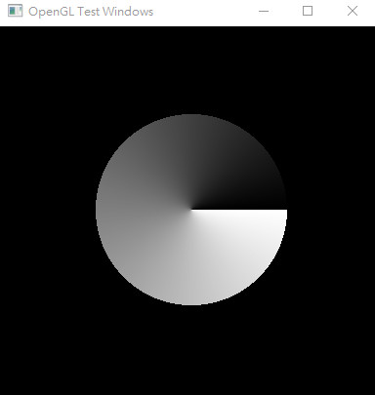
小考
radius = 0.5
slices = 4
radius = 0.5
slices = 360

